Slide 1
Using an interactive dashboard to visualize the prevalence of cigarette, e-cigarette, pipe, cigar, and smokeless tobacco use in the NHIS study from 2012—2022
Olivia Roberts

Slide 2
Introduction
The tobacco and nicotine product landscape is continuously evolving
New products are constantly being developed and sold to consumers before they can be regulated
The last decade has seen an increase in e-cigarette sales in 2017, especially among young adults
In 2021 and 2022, there has been an increase in sales of nicotine pouches (a type of smokeless tobacco product)
Cigarettes, e-cigarettes, cigars, smokeless tobacco, and pipes pose varying health risks
Lung, oral, and other cancers; cardiovascular risks; oral health risks

Slide 3
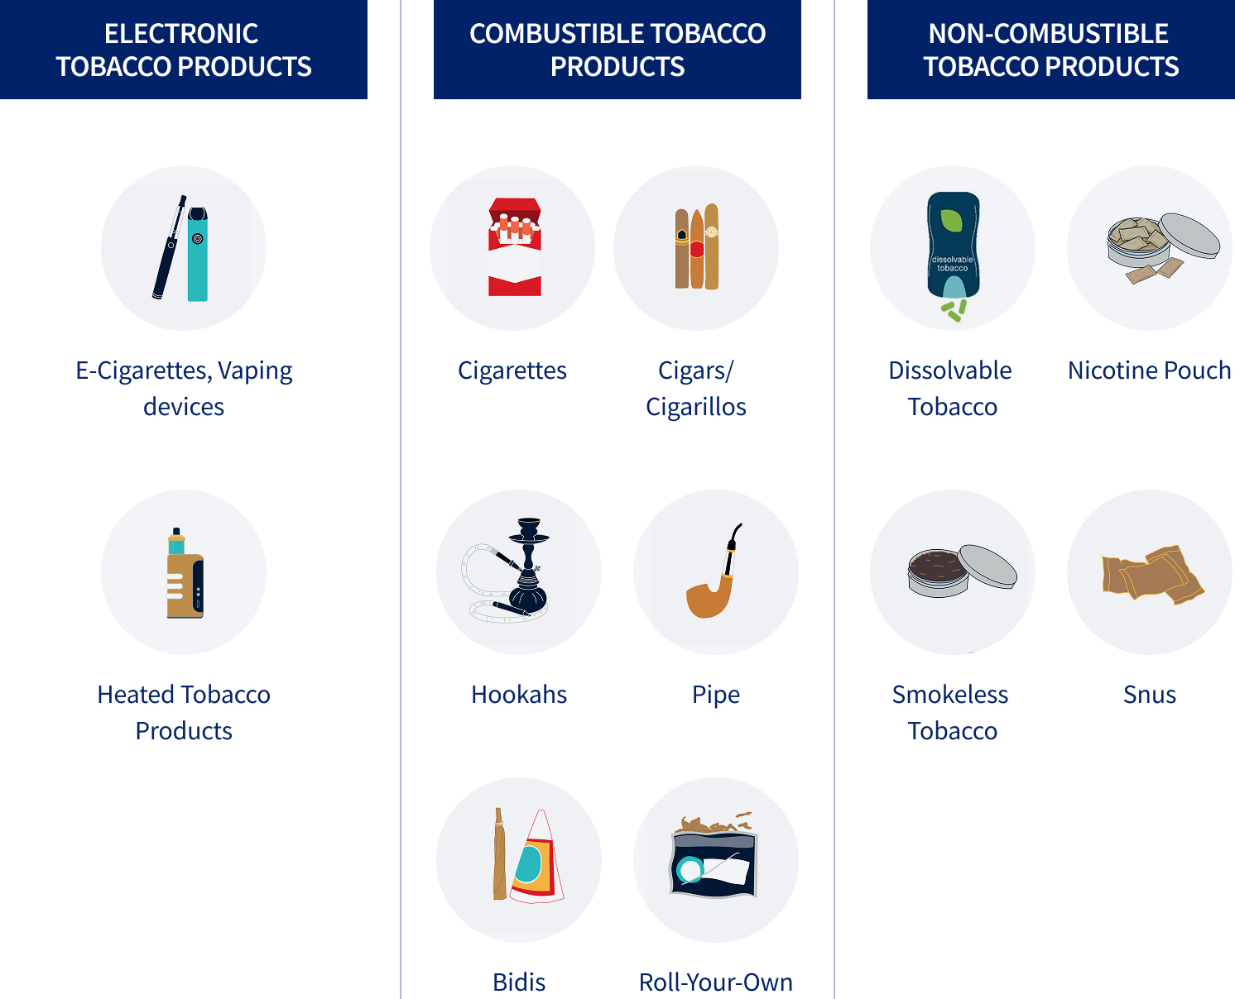
Research question
How has the prevalence of tobacco and nicotine product use changed over time by sex, age group, and race in the U.S. from 2012-2022?

Slide 4

Data
The National Health Interview Survey (NHIS) is a nationally representative, cross-sectional household survey conducted annually since 1957 by the National Center for Health Statistics (NCHS)
Publicly available harmonized longitudinal dataset: 2012–2022
Cigarettes, e-cigarettes, cigars, smokeless tobacco, pipes
Age, sex, race & ethnicity
Complex sampling design: dataset includes sampling weights so nationally representative estimates can be calculated

Slide 5
Methods
Ever and current use variables are derived from questions about:
Ever use of a tobacco/nicotine product
Current use of a tobacco/nicotine product among ever users (every day or some days) and 100+ lifetime cigarettes or cigars
Socioeconomic variables were derived from questions about:
Age: 18-24, 25-34, 35-54, 55+
Sex: male, female
Race & Ethnicity: Hispanic, non-Hispanic White, non-Hispanic Black, non-Hispanic Asian, non-Hispanic Other
Survey design object: survey weights, strata, primary sampling units
Restricted to those 18+ without missing demographic information
596,023 observations in the final cleaned dataset

Slide 6
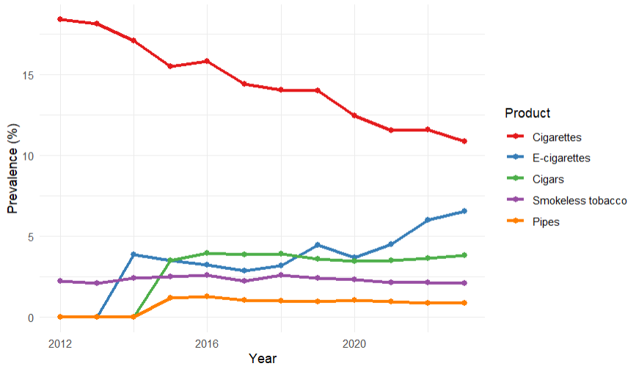
Exploratory data analysis: Current use by product

Slide 7
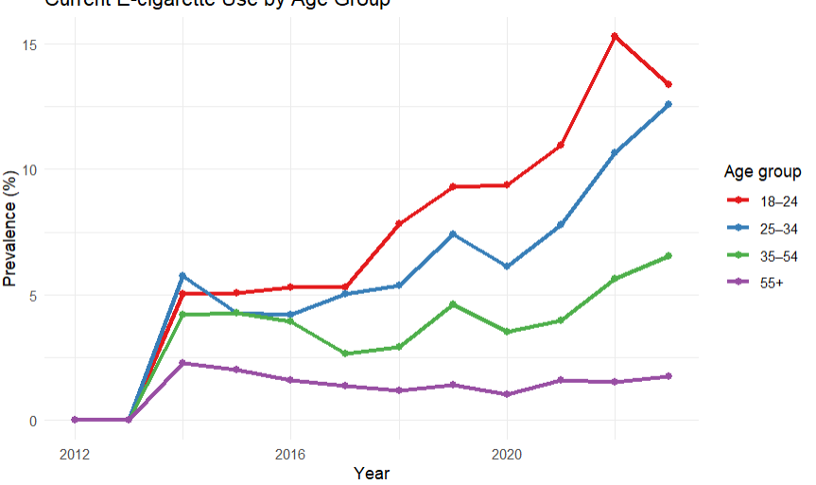
Exploratory data analysis: E-cigarette use by age

Slide 8
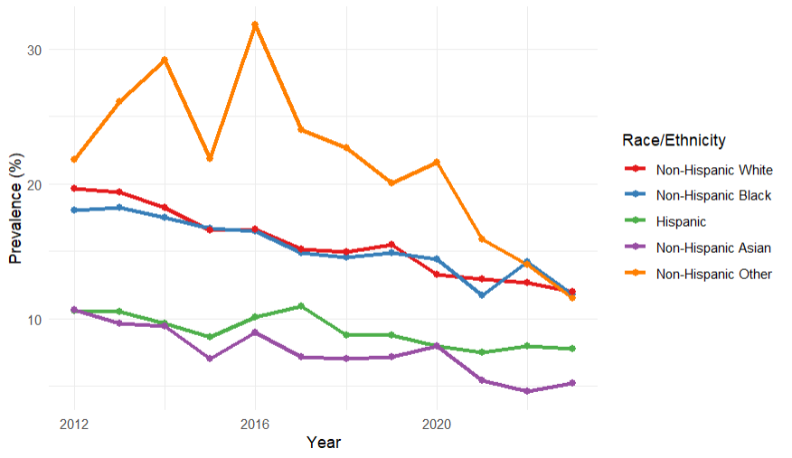
Exploratory data analysis: Cigarette use by race

Slide 9
Interactive dashboard demonstration
https://oliveroberts.github.io/tobacco-project.html (the dashboard is based on a reduced NHIS dataset of 50,000 to improve performance)

Slide 10
Conclusion
Changes in overall tobacco/nicotine product use
Cigarette use declined, e-cigarette use increased
Cigar, smokeless tobacco, and pipe use stayed relatively steady overall
Differences in product use by group
Use of cigarettes, pipes, smokeless tobacco, and cigars has decreased over time for younger age groups, with an increase in e-cigarette use
Men were consistently more likely to use all tobacco and nicotine products
Non-Hispanic White, non-Hispanic Black, and non-Hispanic Other individuals were more likely to use cigarettes
Non-Hispanic Other and non-Hispanic White individuals were the most likely to use e-cigarettes
Non-Hispanic Black individuals were the most likely to use cigars and pipes
Non-Hispanic White individuals were the most likely to use smokeless tobacco

Slide 11
Tobacco regulatory implications
Cigarette use decline is promising for public health, but an increase in e-cigarette use poses a new challenge for tobacco control efforts
Public health interventions should account for disparities between groups to best reduce tobacco-related harm
Continued monitoring of trends is necessary as the tobacco landscape continues to change
Future research should examine transitions between products, dual use (or poly use), and the recent emergence of nicotine pouch products

Slide 12
Questions?

